Slide 1
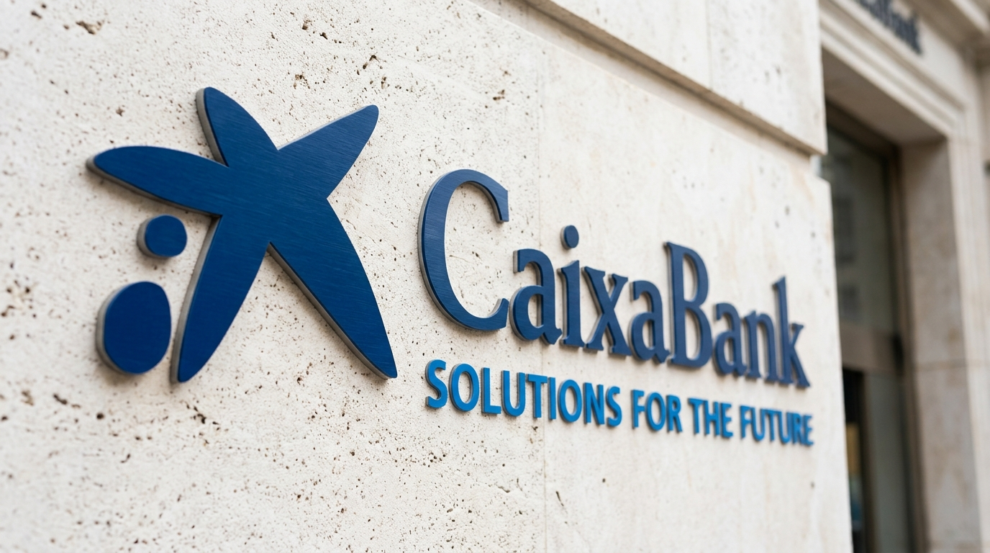
BUSINESS INTELLIGENCE & MARKETING ANALYTICS
Term Deposit Campaign Review
Performance Analysis, Customer Profiling, and Strategic Recommendations
TIMELINE
TARGET PRODUCT
DASHBOARD STATUS
2025 – Campaign Review
Fixed-Term Savings Deposit
Tableau Live Integrated
CaixaBank

Slide 2

EXECUTIVE OVERVIEW
Campaign Subscriptions & Key Metrics
Overall Portfolio Split
TARGET CLIENTS
AVG BALANCE
45,211
$1,362.27
Outbound phone outreach
Client liquidity base
11.70%
Subscribed
AVG DURATION
CELLULAR CONVERSION
4.33 min
14.92%
Subscribers: 5,289
Non Subscribers : 39,922
Key driver for conversion
Highest channel yield
Strategic Baseline
11.7% conversion baseline: Conversion is heavily concentrated in specific customer segments and seasonal calling windows.

Slide 3
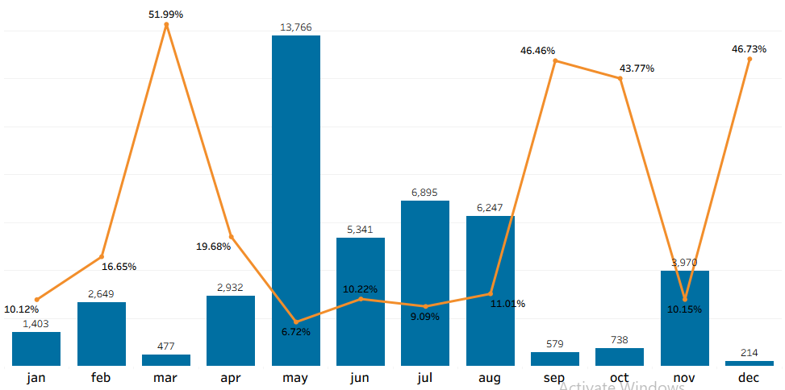
SEASONALITY & TIMING ANALYSIS
Subscription Rate by Month
Monthly Contact (Bars) vs. Subscription Rate % (Line)
Contact
Subscription Rate
May Volume Bottleneck
Peak Efficiency Windows
13,766 calls made in May yielded only 6.72% conversion. High agent fatigue, low subscription efficiency.
March (51.99%), September (46.46%), October (43.77%) and December (46.73%) generate maximum campaign ROI per call.

Slide 4
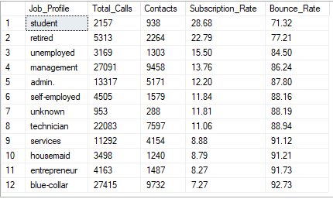
CUSTOMER SEGMENTATION
Subscription Rate By Job Profile
Students and Retired
Students (28.68%) and Retired (22.79%) are the banks absolute best converters. They are locking in deposits at double or triple the rate of other job profiles.
Corporate Base (Management & Admin)
Management (13.76%) and Admin (12.20%) has moderate subscription rates around the bank campaign's global baseline average (~11.7%). With over 14,600 contacts combined, a tiny increase in their conversion efficiency results in a huge surge of actual deposit volume.
Blue-Collar Workers
Largest volume of phone calls 27415 went to this group with abysmal 7.27% subscription rate. sales team is wasting an incredible amount of time calling blue-collar leads for very little return

Slide 5
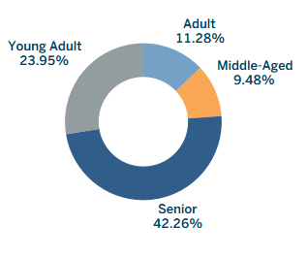
CUSTOMER SEGMENTATION
Age Group Analysis
Age Group Conversion Curve
Seniors & Young Adults
Senior (42.26%) and Young Adults (23.95% ) are the banks best 2 performing age group . They also make quick decisions requiring the shortest conversion talk time at average of just 6.66 minutes.
The Operational Reality
Despite being the banks absolute best segments, the marketing team barely targeted them. Together, Seniors and Young Adults make up less than 6% of total customers contacted (2,524 out of 45,211).
Adults & Middle-Aged
The bank poured 94.4% of its total call volume (42,687 customers combined) into these two groups. Their Subscription Rates drop significantly to 11.28% for Adults and a rock-bottom 9.48% for the Middle-Aged. To win a subscription from these groups, sales agents are forced to stay on the phone for 9.20 to 9.64 minutes per successful call, massive waster of call center labor for low returns.

Slide 6
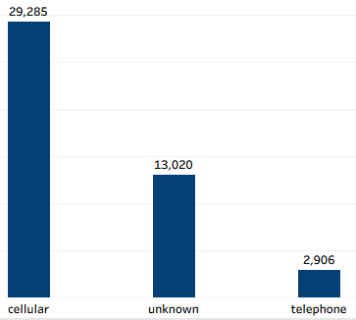
CAMPAIGN CHANNEL ANALYSIS
Campaign Channel Utilization & Yield Analysis
Contact by Channel
Subscription Yield % by Channel
Cellular
Subscribers: 4,369
14.91% Conversion
Unknown
Subscribers: 530
4.07% Conversion
Telephone
Subscribers: 390
13.42% Conversion
Telephone
Cellular Dominance
Unknown Channel Drain
This represent a tiny fraction of the bank’s campaign (2,906 contacts) but deliver very solid and stable 13.42% Subscription Rate. The time-to-close a deal (8.46 minutes) is identical to a mobile phone. The bank should scale up and continue utilizing this channel.
Cellular is the bank’s core operational channel. It manage 64.8% of all outreach; yields highest overall subscription rate (14.92%).
13,020 calls with missing channel data produce an abysmal 4.07% conversion. Channel is actively draining the banks marketing budget and wasting valuable sales hours.

Slide 7
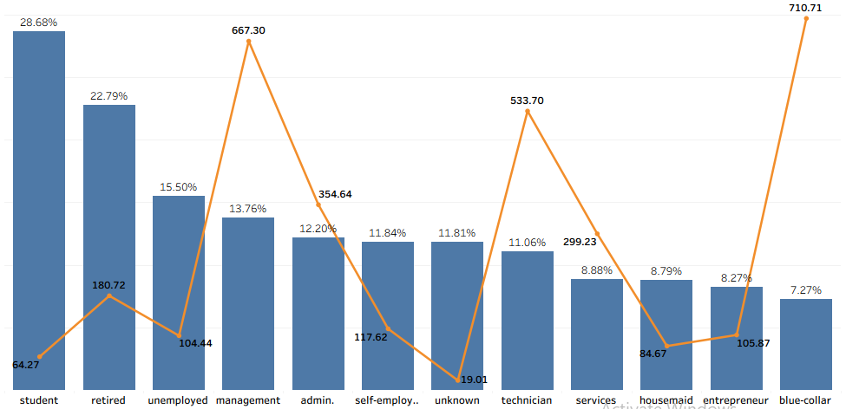
CAMPAIGN CHANNEL ANALYSIS
Campaign Channel Utilization & Yield Analysis
(Subscription Rate (bar) vs Call Time (hrs) line) by Job Type
Age Group Conversion Curve
Operational Imbalance
Over-Targeting the Wrong Groups:
The best-converting segments/demographics Student & Retired did not get enough call hours
Sales team spent thousands of hours talking to middle-aged professional segments (Blue-collar or Services) that consistently said “no”. resulting in massive wasted call hours

Slide 8
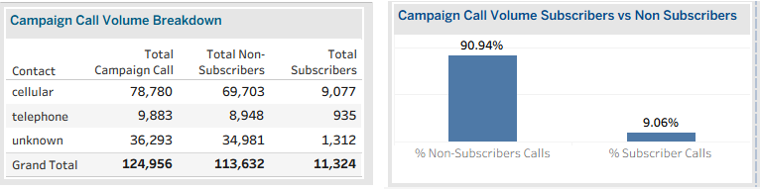
CAMPAIGN CHANNEL ANALYSIS
Campaign Channel Utilization & Call Volume Breakdown
Labor & Call Hours Loss
Sales team spent hours calling 39,922 customers that consistently said “no” with some phones dialed multiple times totaling 113,632 calls. With majority of this call going to demographics with low subscription performance and customers with missing/unknown records, phone calling this list blindly siphoned 90.94% of the banks campaign budget.

Slide 9
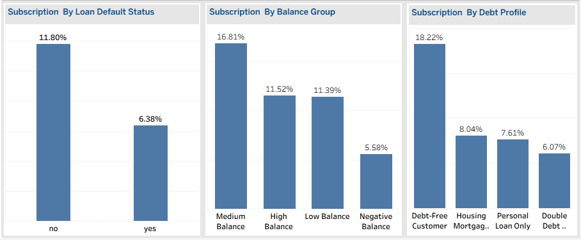
INVESTMENT CAPABILITY
Investment Capability
Loan Default Status - Strong Predictor
Medium Beats High Balance
Debt Profile Suppress Conversion
Takeaway: To protect campaign efficiency, minimize outreach to profiles with a recorded loan default history.
Takeaway: Prioritize the "Medium Balance" demographic. High-balance users might be too selective or using other wealth management channels, while negative-balance users lack the capital to subscribe.
Debt-Free is King: Customers who are completely Debt-Free convert at a stellar 18.22%. Financial liability is a massive barrier to a customer saying "yes. Weigh marketing efforts toward debt-free individuals.

Slide 10
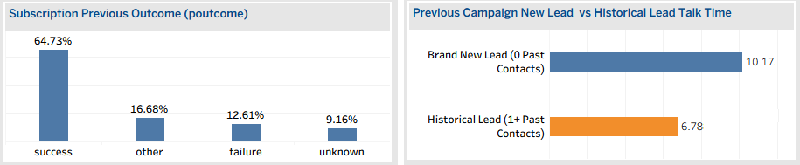
CUSTOMER ENGAGEMENT HISTORY
Historical Engagement (Prior Campaign Outcome)
Prior Campaign Success ('Success')
Relationship Equity is Strong
Clients who subscribed in previous campaigns convert at an astounding 64.73% rate (963 subscribers out of 1,511 contacts).
Previous Failures (Failure)
Clients with non-conversion past history convert at 12.61% upon re-engagement.
Historical Leads: This segment of customers require the shortest talk time to win a conversion, call agents only need to speak with them for an average of 6.78 minutes. They already trust the brand, hence, sales pitch is short and direct.
Brand New Leads: To win a subscription from a brand-new lead, call agents have to talk for a massive average of 10.17 minutes.

Slide 11
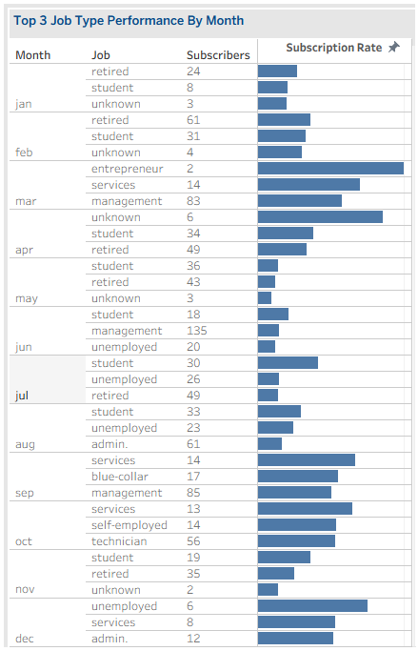
TIMING AND SEASONALITY
Review Period Top 3 Performing Job Profiles
Students and Retired Profiles Dominant
Out of the 12 months in the year, Students hit the Top 3 list 8 times, and Retired individuals hit it 6 times.
Management & Admin High - Volume Valuable to The Bank
Management (Months 3, 6, 9) and Admin (Months 8, 12) represent massive pools of potential customers. With subscription rate above the banks baseline, they are more valuable to the bank's bottom line than profiles with a 100% conversion rate on 2 contacts.
Extreme Subscription Spikes With Low Call Volume
Month 3 (Entrepreneur):100.00% subscription rate (2 contacts)
Month 4 (Unknown): 85.71% subscription rate (7 contacts)
Month 12 (Unemployed): 75.00% subscription rate (8 contacts)
Key Takeaway: While subscription rate is, the small audience sizes cannot sustain a massive bank campaign.

Slide 12
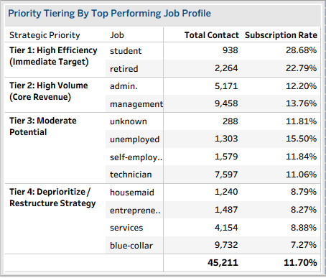
PRIORITY TIERING
Job Profile
Priority Tier
Tier 1 and 2 are the banks high performing demographics to maximize total campaign revenue.

Slide 13
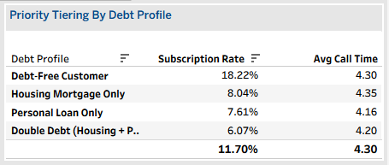
PRIORITY TIERING
Debt Profile
Debt-Free Customers
Debt-Free customers are Caixa Bank most responsive and lucrative segment. 1 in 5 Debt-Free Customer subscribe, converting at 18.22%.
They are not burning cash on monthly interest payments, they have surplus capital available to lock away into the bank’s term deposits to earn interest.

Slide 14
MISSING/UNKNOWN CONTEXT
Missing Data Gaps Across Critical Dimensions
Unknown & Missing Data Gaps
Data gaps are costing CaixaBank massive efficiency leaks, particularly in the contact channel 13,020 and (poutcome) previous outcome 36,959 fields.
(poutcome): A massive 36,959 rows are marked as unknown. While this group generated 3,386 subscriptions, their Subscription Rate is a low 9.16% (3,386 ÷ 36,959), confirming that when the bank doesn't track a lead's historical relationship, call agents are flying blind and getting rejected 91% of the time.

Slide 15
CAIXABANK TELEMARKETING CAMPAIGN REVIEW
Strategic Roadmap, Operational Recommendations & Action
Immediate Actions for The Next Campaign
• Operational Resource Shift: Reallocate 85% of live agent calling hours to Tier 1 Demographics (Students/Retired) and Warm Contacts (>30 days since interaction).
• Filter out low-balance accounts, focus outbound calls strictly on clients in the Medium Balance Group: $1,804 – $5,000 with active no loans prior to campaign launch.
• Deprioritize massive phone/outreach campaigns to Tier 4 . Use low-cost, fully automated email or SMS track rather than wasting expensive live telemarketing agent hours and labor on them.
• Reduce call volume in May by 50% and shift telemarketing agents to March, September, and Q4 windows.
• Institute a strict 3-call limit per customer contact cycle to eliminate lead burnout.
• Maintain Cellular as baseline communication channel. It offers the best combination of volume 64.8% of all outreach , speed-to-close 8.39 minutes, and conversion probability 14.92%.
•Continue utilizing Telephone channel. Though it represent a tiny fraction of the bank’s campaign (2,906 contacts), it deliver a very solid and stable 13.42% Subscription Rate.
• Discontinue Unknown Contact Channels, it is actively draining the banks marketing budget and wasting valuable sales hours because of poorly logged outreach attempts.
• Implement a "Talk-Time Cap" Rule: Since "Unknown" calls stretch to 14 minutes, if a call on an unverified channel crosses the 9-minute mark without a clear commitment or closing path, the agent must politely end the call to reclaim sales capacity.
• Establish monthly campaign capacity caps based on historical seasonal conversion. Limit determined by how well customers historically convert during that specific month.
• Prioritize Historical Lead Funnel: The bank should strictly exhaust all historical campaign (success) lists before launching cold outreach. Warm leads yield a 2.5x higher sales return in much shorter time frames.

Slide 16
CAIXABANK TELEMARKETING CAMPAIGN REVIEW
Strategic Roadmap, Operational Recommendations & Action
Long Term Actions for The Next Campaign
• Implement a Lead scoring model prioritizing Young Adults, Seniors for age group , Students, Retired, Management, Admin for job profile, Tertiary-educated for education, and Debt-free profiles.
• Implement a scoring model prioritizing Young Adults, Seniors for age group , Students, Retired, Management, Admin for job profile, Tertiary-educated for education, and Debt-free profiles.
• Implement a data-governance rule on CRM that blocks call agents from submitting or launching campaigns against accounts missing a specified data to eliminate the "Unknown" bucket.
• Migrate Landlines to Mobile Tracks: During successful landline calls, instruct agents to request a mobile number to naturally migrate these highly stable customers into the banks high-volume digital or automated SMS/app messaging streams.
• Mandate call duration optimization training focused on building rapport during minutes 2 to 5.
• Reallocate Agent Capacity: Assign Caixa Bank most experienced, high-performing sales agents to the Brand New Lead pool (where the sales friction is highest) and allow junior agents or automated channels to handle the high-converting Historical Leads.
•Continue calling the 3,386 subscribers sitting inside the unknown poutcome, 252 unknown education, 34 unknown job, 530 unknown contact channel to instantly update their profile so that they are accurately profiled for next campaign.

Slide 17
Term Deposit Campaign Analytics
Data-Driven Strategy for Conversion Optimization & Resource Capacity Management
Prepared for Executive Stakeholders

